Slide 1
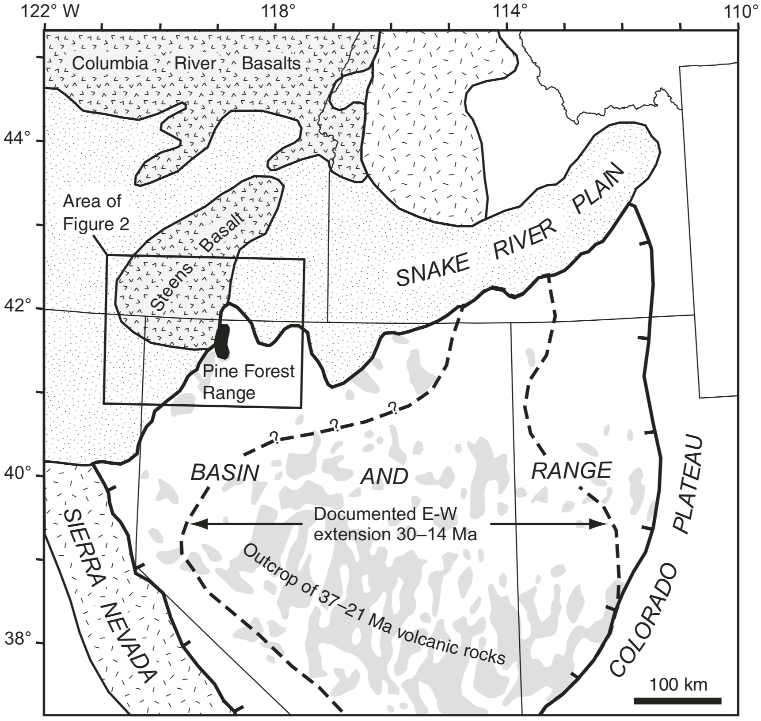
Timing of Cenozoic volcanism and Basin and Range extension in northwestern Nevada: New constraint from the northern Pine Forest Range
Colgan et al. 2006
Presented by Luke J. Schranz

Slide 2
“This study aims to better document the timing of Basin and Range extensional faulting and Cenozoic volcanism in northwestern Nevada and, in particular, to determine if there is evidence for extensional faulting prior to the late Miocene high-angle faulting that formed the modern ranges in the region.”
Basing and range faulting poorly understood in northwestern NV
Previous studies suggest early Miocene extensional faulting may be preserved in this region
Pine Forest range: Well preserved geologic relationships
Oligocene to middle Miocene strata well preserved

Slide 3
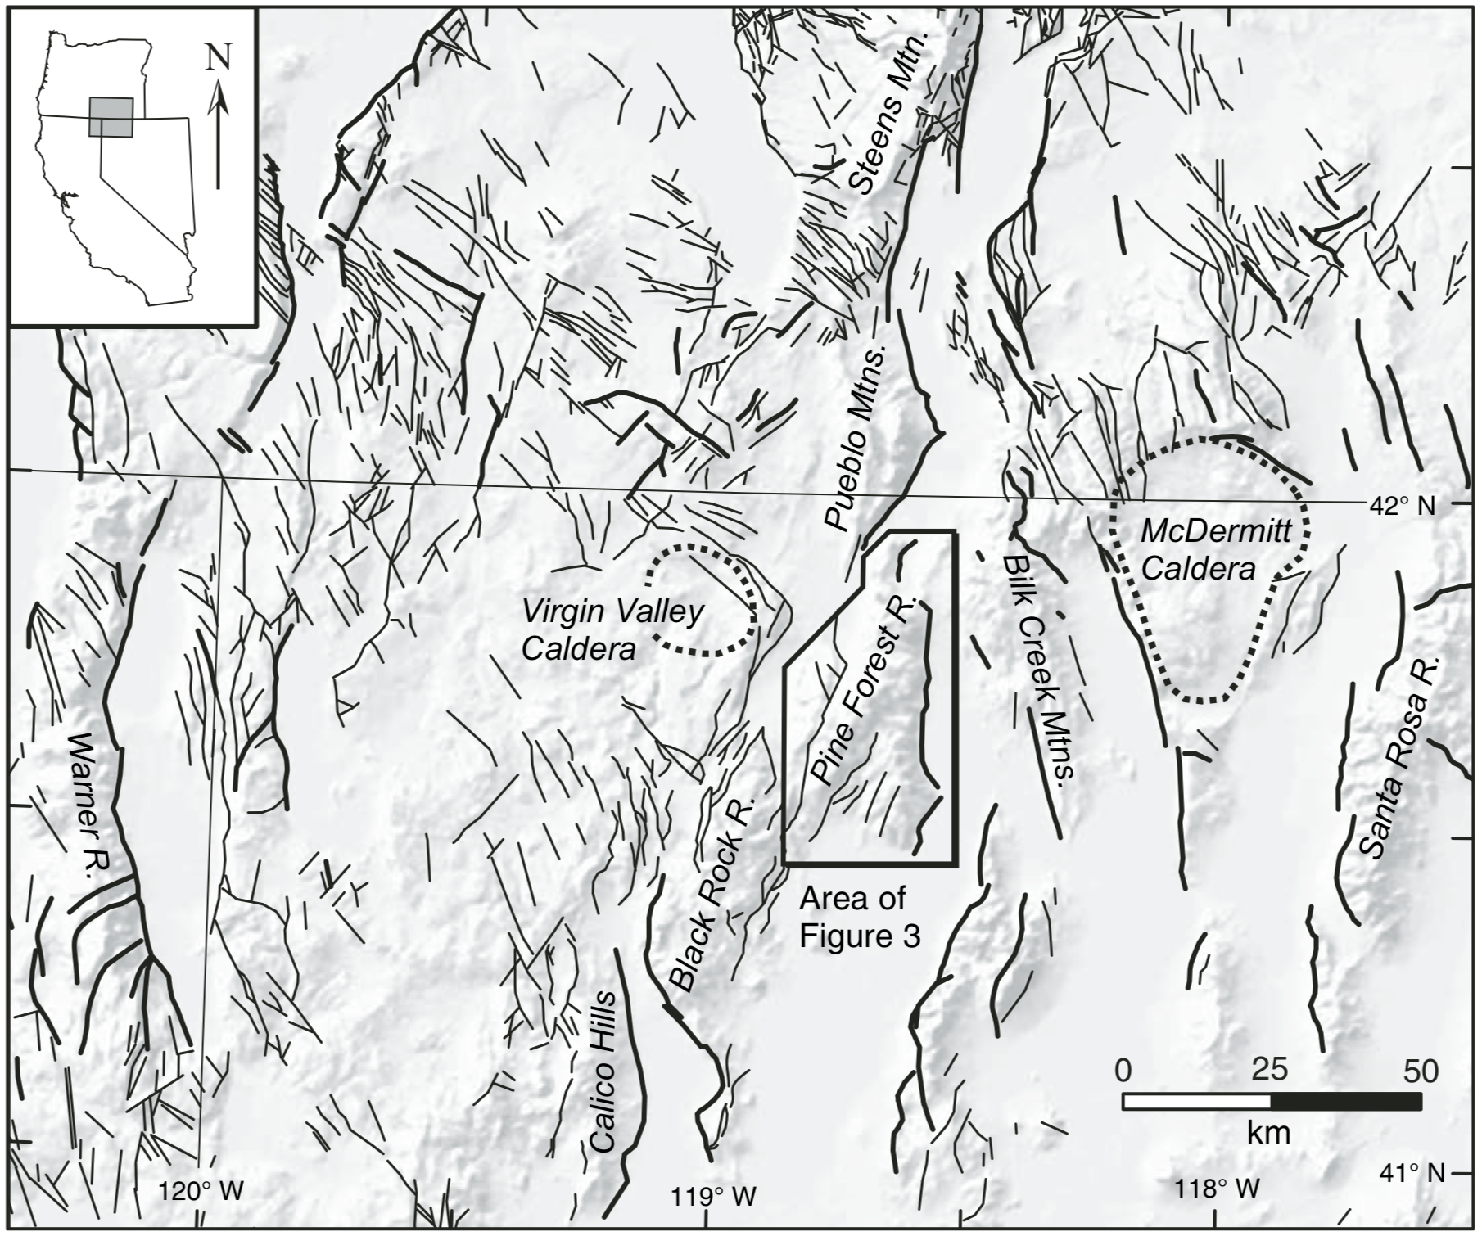

Slide 4
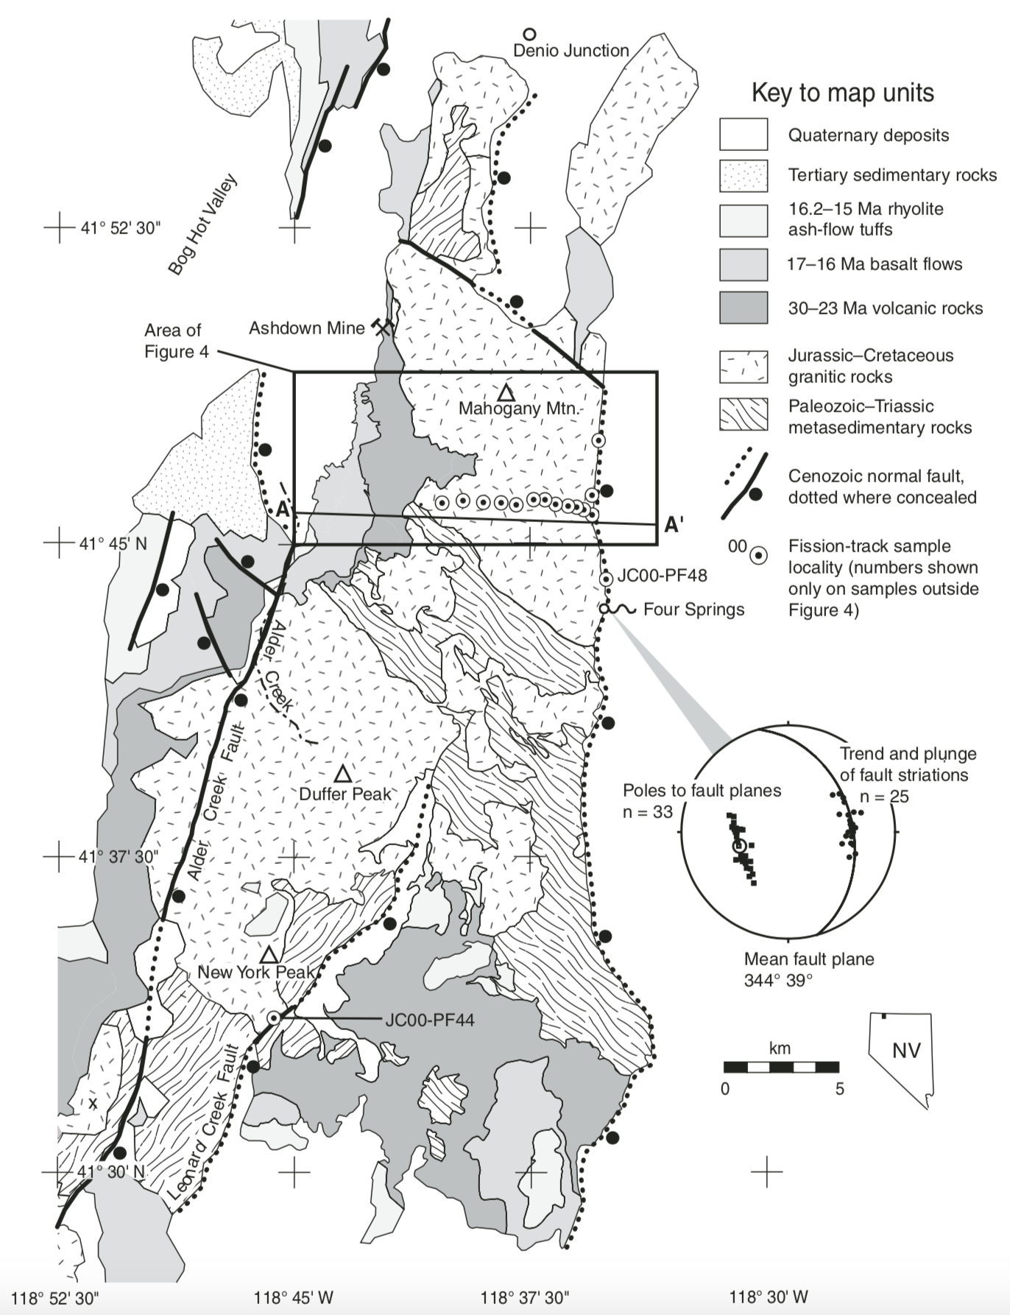

Slide 5
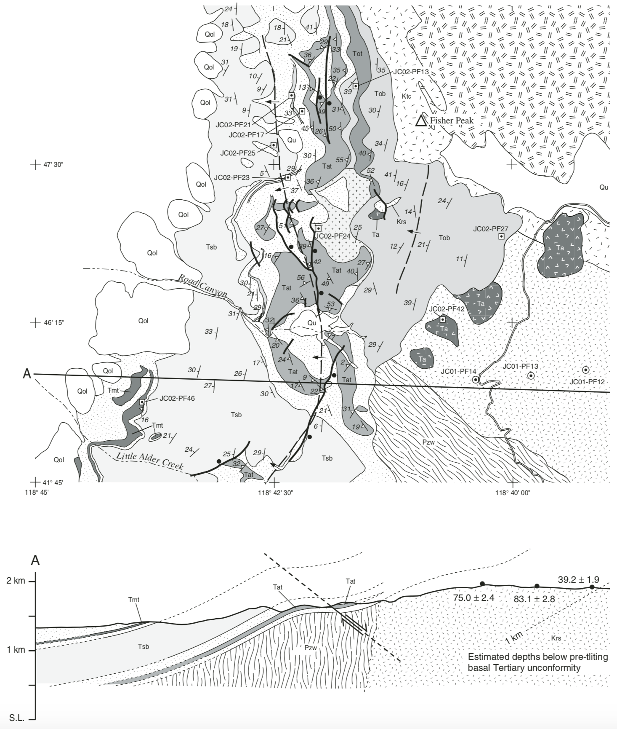
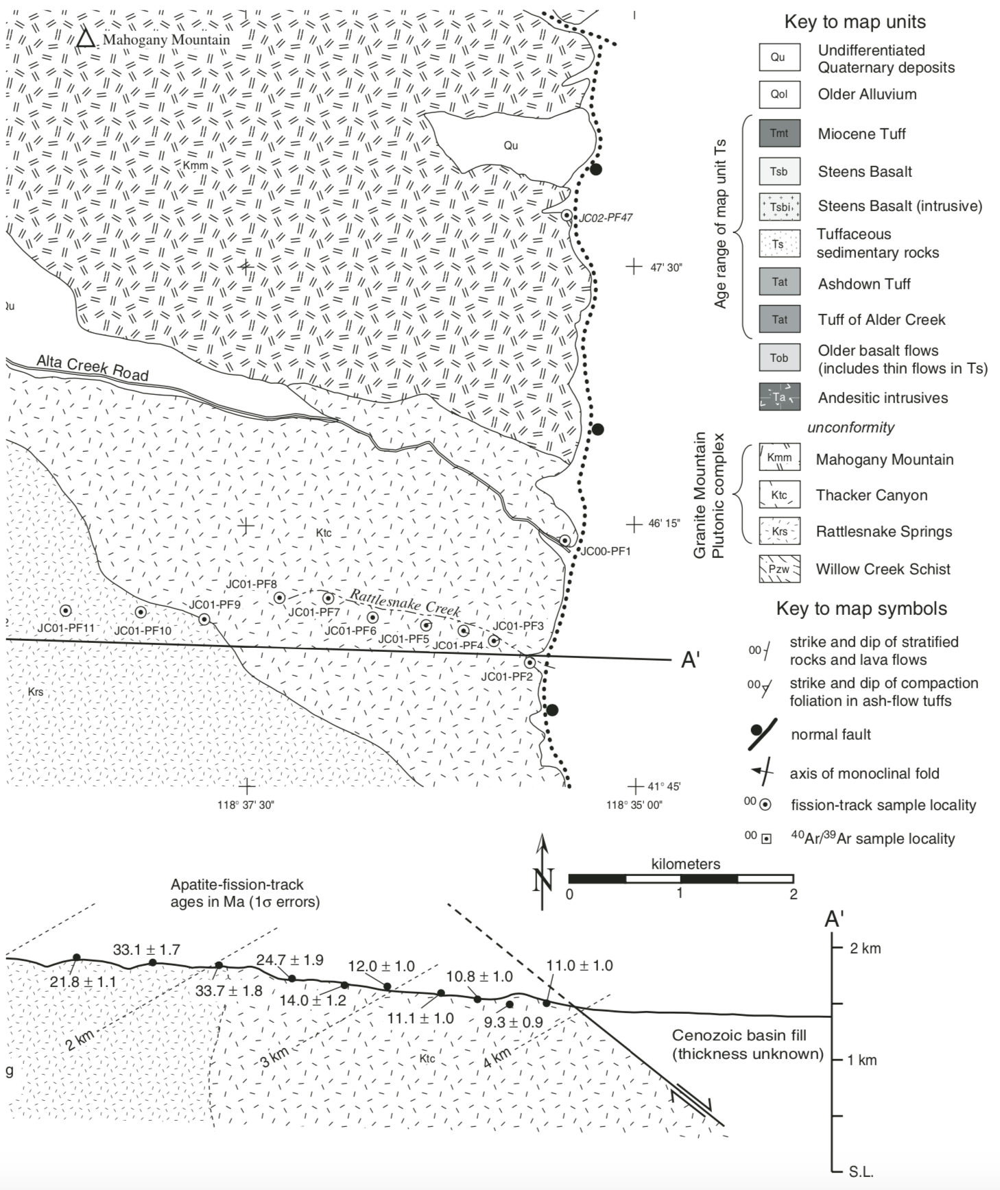

Slide 6
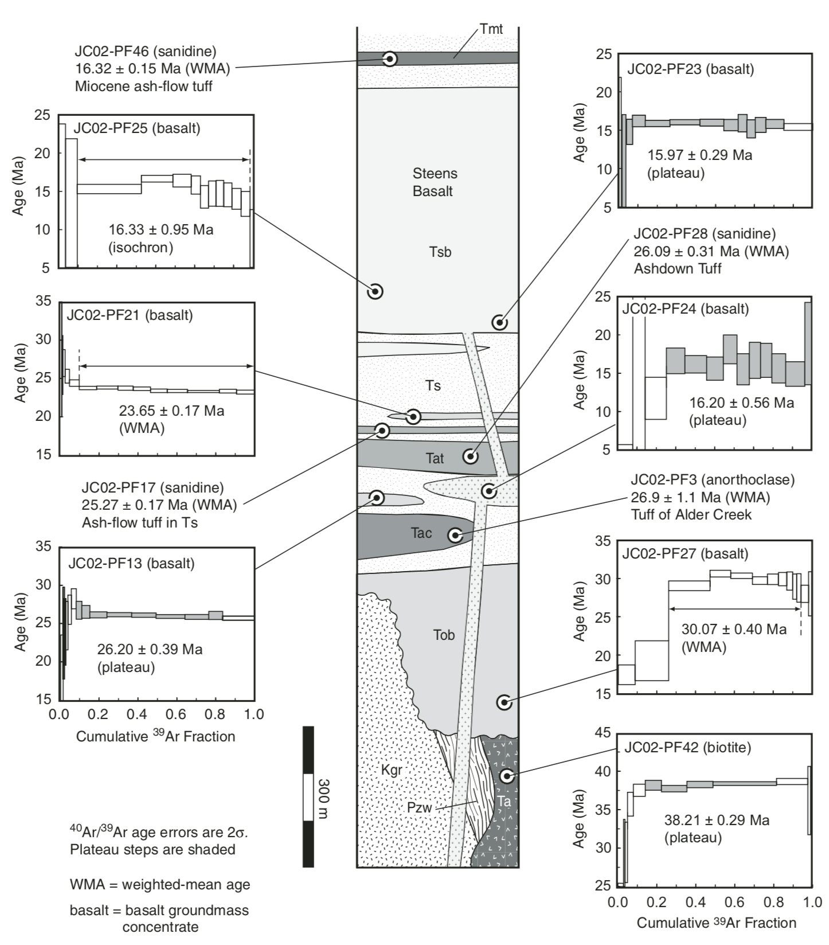
30-23 Ma Oligocene rocks are bimodal and alkaline
17-16 Ma Miocene basalt-rhyolite suite conformably overlies

Slide 8
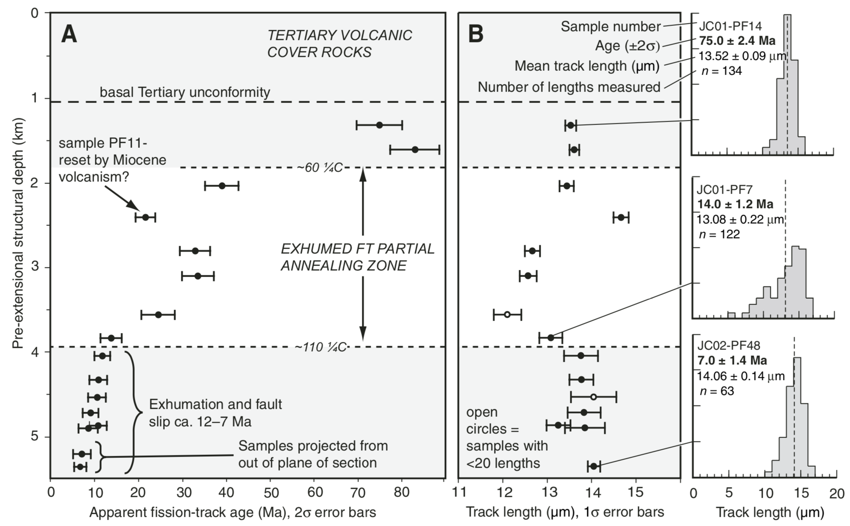

Slide 10
Conclusions
Oligocene bimodal rocks are distinct from calc-alkaline ignimbrites to the south and east
Miocene rocks conformably overlie Oligocene rocks = no tilting between Oligocene and Miocene (30-60 Ma)
12-11 Ma onset of basin and range faulting, until 10-7 Ma
Distinct from mid-Miocene onset of extension throughout the greater Basin and Range

Slide 11
Questions

